Slide 1
Hack the Future:
A Gen AI Sprint Powered by Data

Slide 2






Hack the Future: A Gen AI Sprint Powered by Data
Data and AI Week
Team details
TEAM NAME:
Saumya Dash
Harishankar Vashishtha
(Team Leader)
Photo

Slide 3
Entry Submission Summary
Idea Title (Provide a aand impactful title for your idea.) | ScreenWise – Intelligent Resume Screening for Modern Hiring Teams
Team Name | Team S&H Nexus
Problem Statement | Enhancing Job Screening with AI and Data Intelligence
Proposed Solution | An AI-powered job screening system using LangChain Agents to automatically parse, match, score, and communicate candidate outcomes based on CV and JD analysis.

Slide 4
Problem statement you are trying to address
The traditional job screening process is often time-consuming, inconsistent, and prone to human bias. Recruiters manually review large volumes of resumes and job descriptions, which not only delays hiring but also increases the chances of overlooking qualified candidates. Additionally, lack of standardized shortlisting criteria and delayed communication with applicants can lead to a poor candidate experience and reduced efficiency in the hiring funnel.

Slide 5
Proposed Solution Overview
To address the inefficiencies and subjectivity in traditional recruitment screening, we propose an AI-powered automated solution leveraging LangChain Agents and Tools to streamline and enhance the job screening process.
Key Components of the Solution:
Document Parsing Agent
Utilizes LangChain tools to read and extract content from resumes and job descriptions in PDF format.
Applies semantic analysis to ensure accurate understanding of both candidate profiles and job requirements.
Matching & Scoring Engine
Uses Natural Language Processing (NLP) techniques to compare candidate resumes against job descriptions.
Computes a matching score based on skills, experience, role relevance, and contextual fit.
Customizable threshold to determine shortlisting criteria.
Decision-Making Agent
Based on the matching score, the agent decides whether the candidate is shortlisted or rejected.
Automated Communication Tool.
A LangChain-integrated tool that sends personalized emails to candidates with their status (shortlisted/rejected).
Email templates are dynamic and tailored based on the screening outcome.

Slide 6
Technologies Used
LangChain Agents & Tools – For building intelligent, modular workflows that parse and analyze resumes and JDs.
Streamlit – To create an interactive and user-friendly frontend with two modes: single resume and bulk upload (ZIP of resumes).
Python – Core programming language used for logic implementation and data processing.
PDFplumber / PyMuPDF – For extracting text from resumes and job descriptions in PDF format.
OpenAI / LLM APIs – To power semantic understanding and scoring logic.
Email Libraries (smtplib / LangChain Tool) – For sending dynamic acceptance/rejection emails based on screening results.
Pandas / Numpy – For data manipulation and scoring logic.

Slide 7
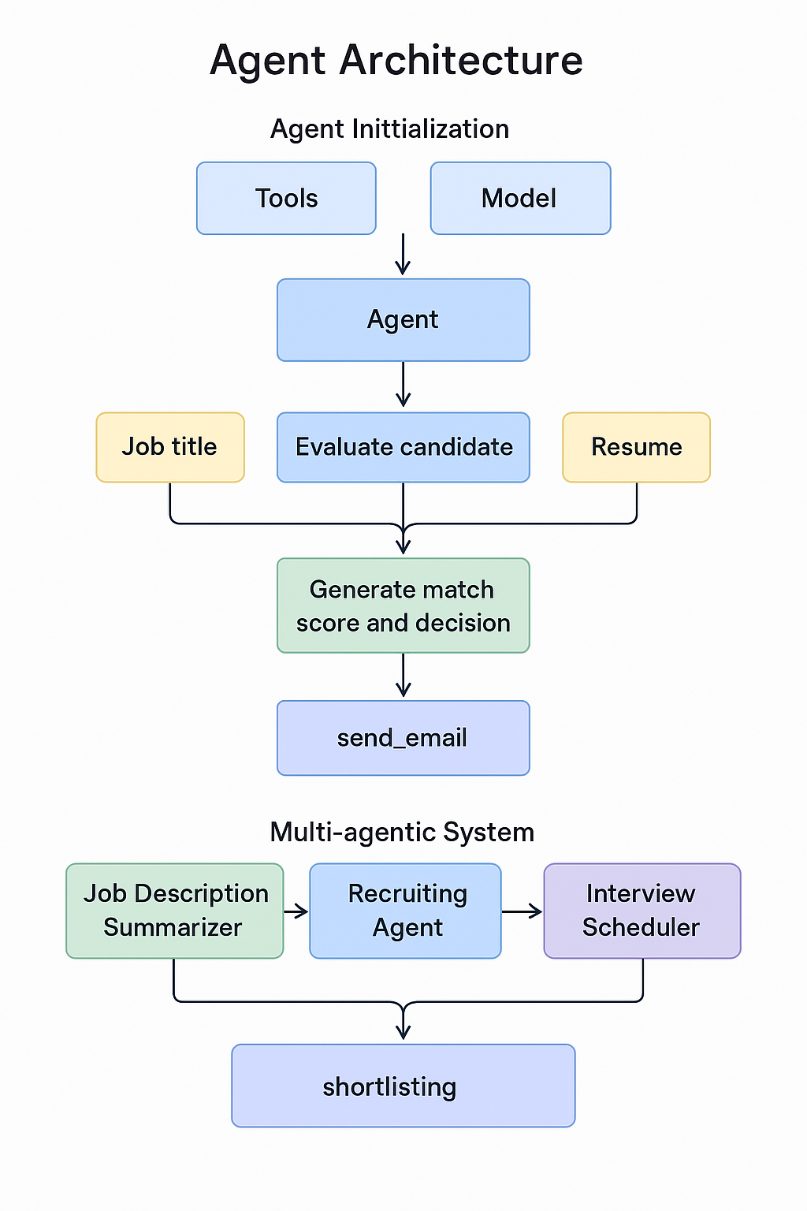
Agents' interaction design

Slide 8
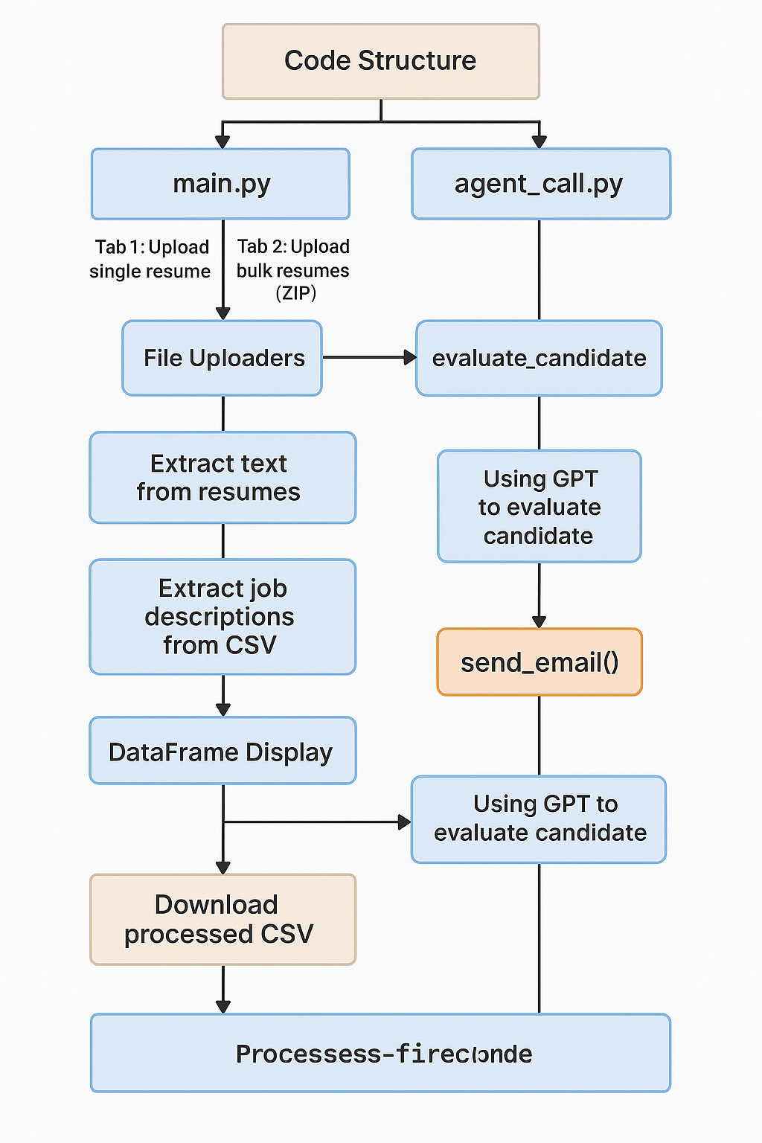
Code structure

Slide 9
Demo video
Link:
Link to the demo video
https://drive.google.com/file/d/17A8FZdiyxGaWYc9BJYrdE1KCz6Cg_Xfg/view?usp=sharing

Slide 10
Conclusion
This solution automates and standardizes the resume screening process, ensuring faster and more accurate shortlisting of candidates. By leveraging AI and natural language processing, it matches resumes against multiple job descriptions in real-time and generates objective, consistent scoring.
The Streamlit-based frontend offers flexibility with single and bulk resume processing, enhancing user experience for both recruiters and HR teams. Additionally, the automated email communication improves candidate engagement and reduces manual follow-ups.
Overall, the system directly addresses the problem of manual inefficiencies and bias in traditional screening, resulting in reduced hiring time, improved accuracy, and a scalable recruitment workflow.

Slide 11
References/Other details
Github:
Github Repo link
https://github.com/vashishthaharishankar/Accenture-hackathon-sau-hari

Slide 12

Thank You

